Slide 1
Git – first steps
For those who make first steps in version control

Slide 2


Gergel Gorvat
Front-End Developer

Slide 3
is this a subway map?!

Slide 4
What says Wikipedia about git
Git (/ɡɪt/)^{[7]} is a distributed version-control system for tracking changes in source code during software development.^{[8]} It is designed for coordinating work among programmers, but it can be used to track changes in any set of files. Its goals include speed,^{[9]} data integrity,^{[10]} and support for distributed, non-linear workflows.^{[11]}

Slide 5

Version: 8
Version: 11
Version: 6
Version: 3
Version: 2
Version: 1
Version: 9
Version: 5
Version: 10
Version: 7
Version: 4

Slide 6
CTRL + Z

Slide 7
ROADMAP
Download and install Git
Check git --version
Create account
Create new repository
Init git locally
Link the local and remote repositories

Slide 8
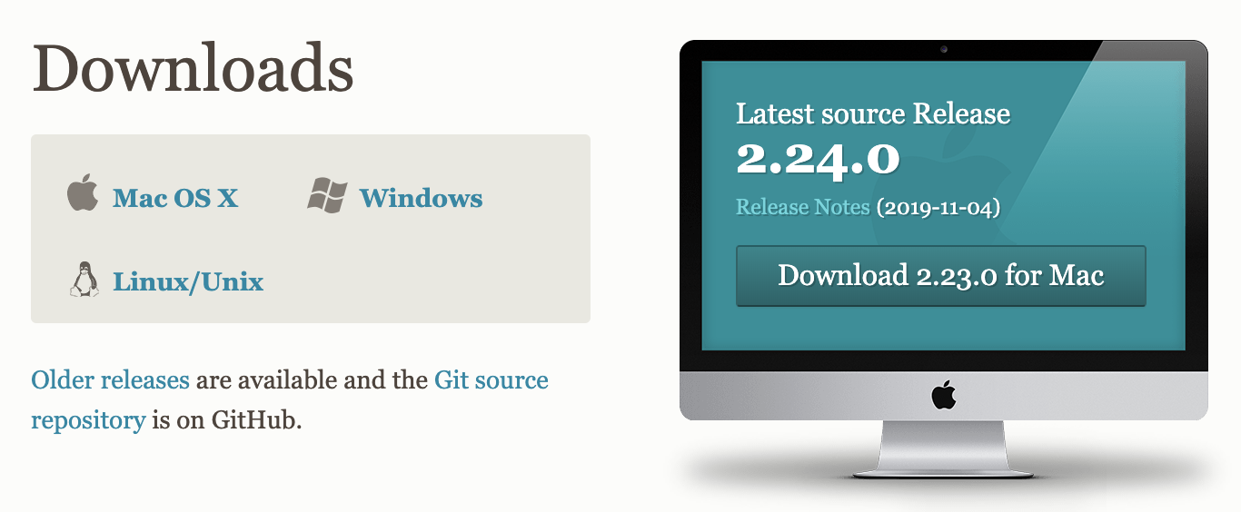
Download and install Git
https://git-scm.com/downloads

Slide 9
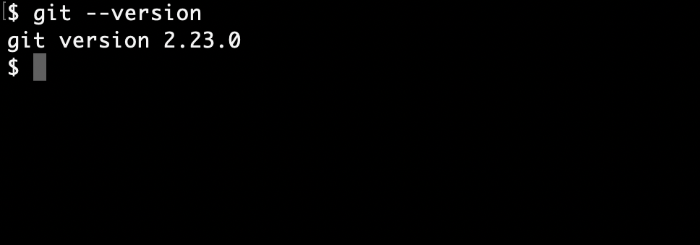
Check git --version

Slide 10
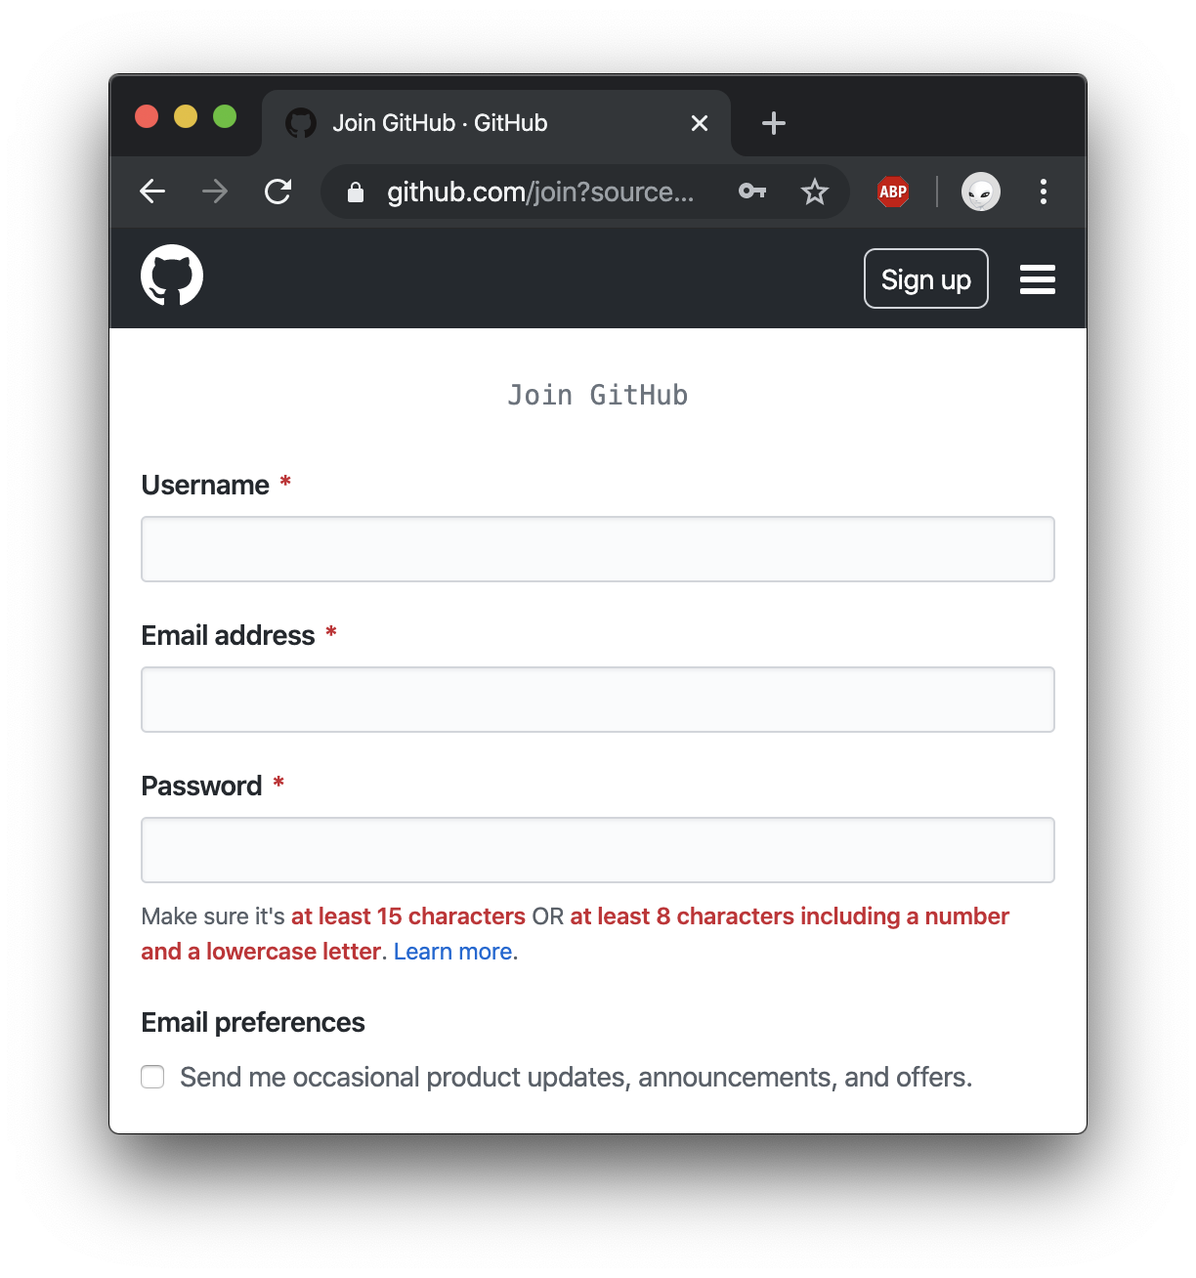
Create account
Fill:
- username
- email
- password
Create

Slide 11
If you can see this, you are ready to read the next slide

Slide 12
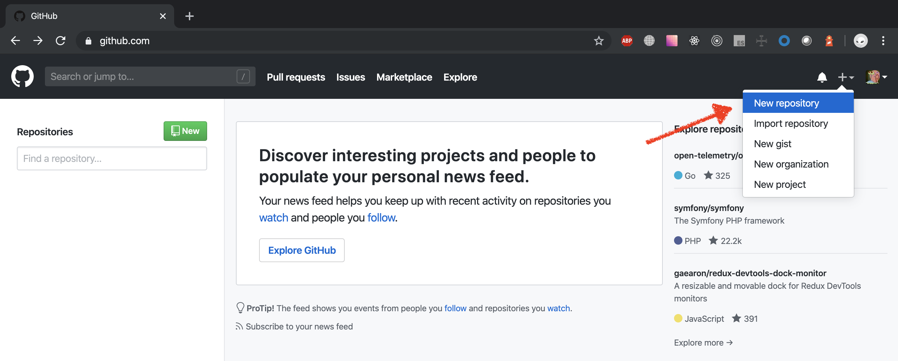
Create new repository

Slide 13
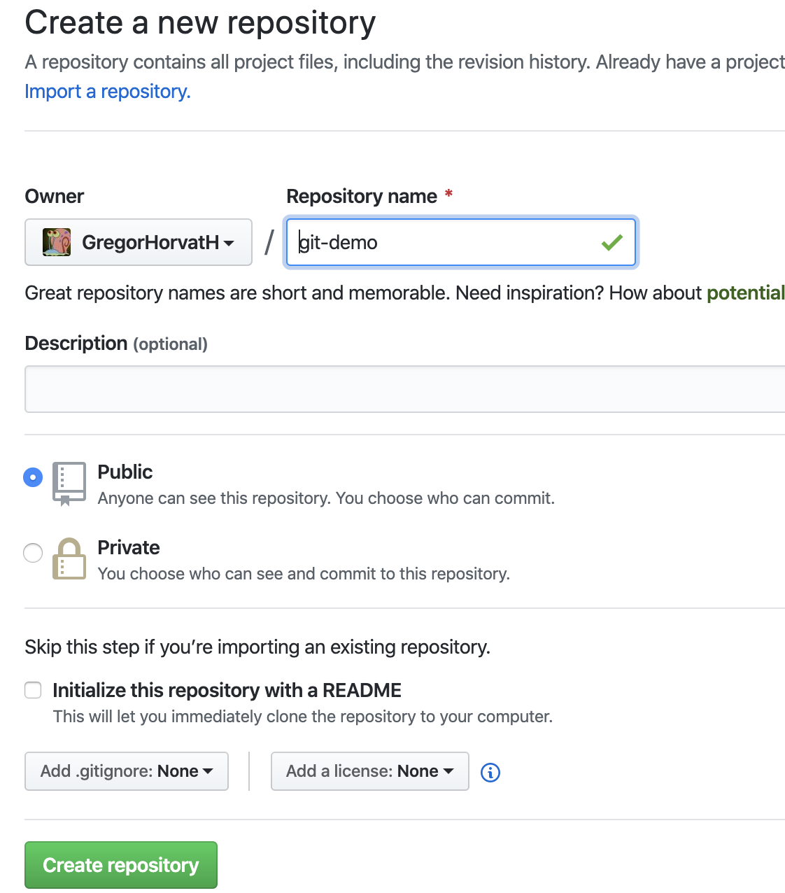
Without readme.md
create new repository, variant 1
1
Repository name
Description (optional)
Do NOT check “Initialize this repository with a README”
Create repository
2
3

Slide 14
Init and Link the local and remote repositories
create new repository, variant 1
echo "# git-demo" >> README.md (just create a file)
git init
git remote add origin https://github.com/YOUR-GIT/git-demo.git
git add README.md
git commit -m "first commit”
git push -u origin master

Slide 15
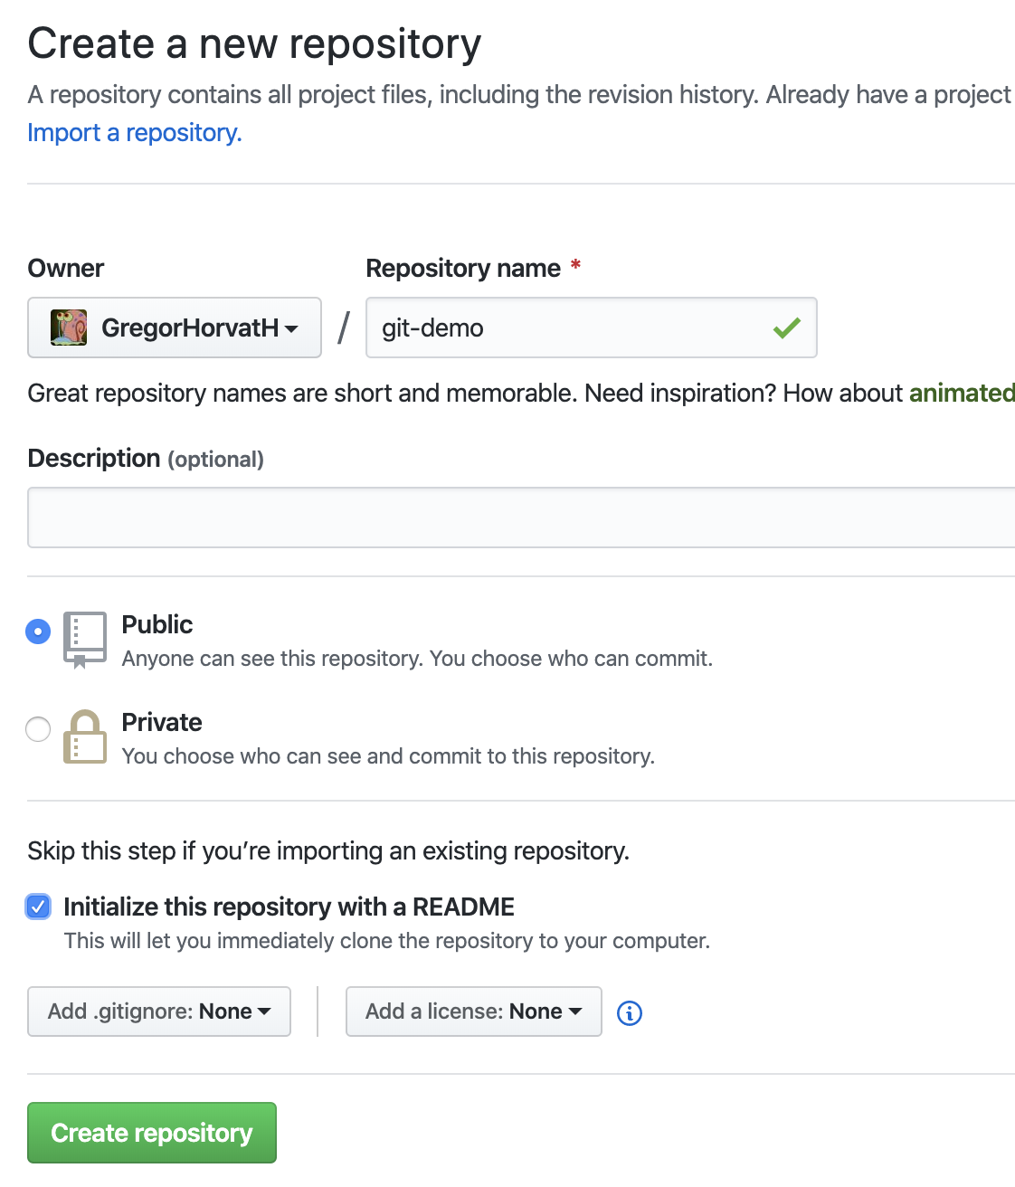
With readme.md
create new repository, variant 2
1
Repository name
Description (optional)
Check “Initialize this repository with a README”
Create repository
2
3

Slide 16
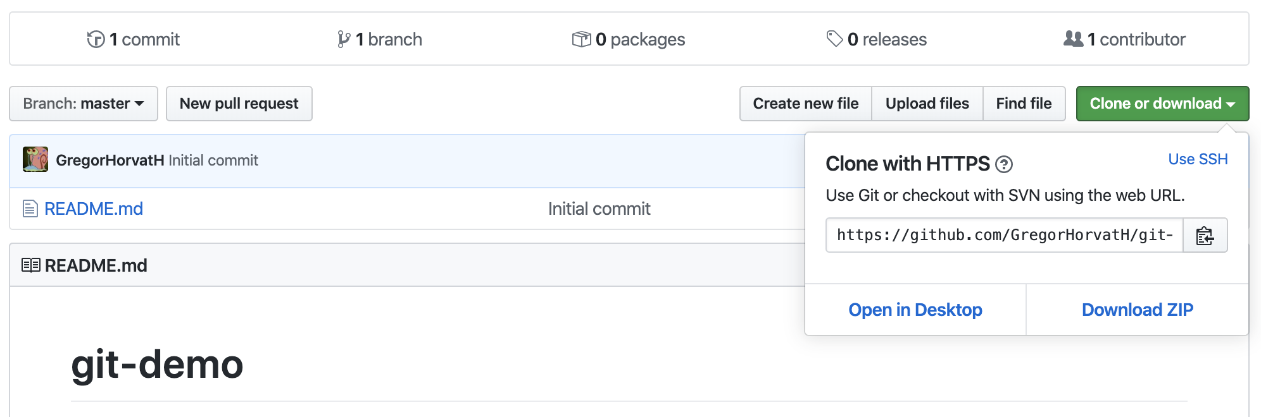
Clone the remote repository
create new repository, variant 2
1
2

Slide 17
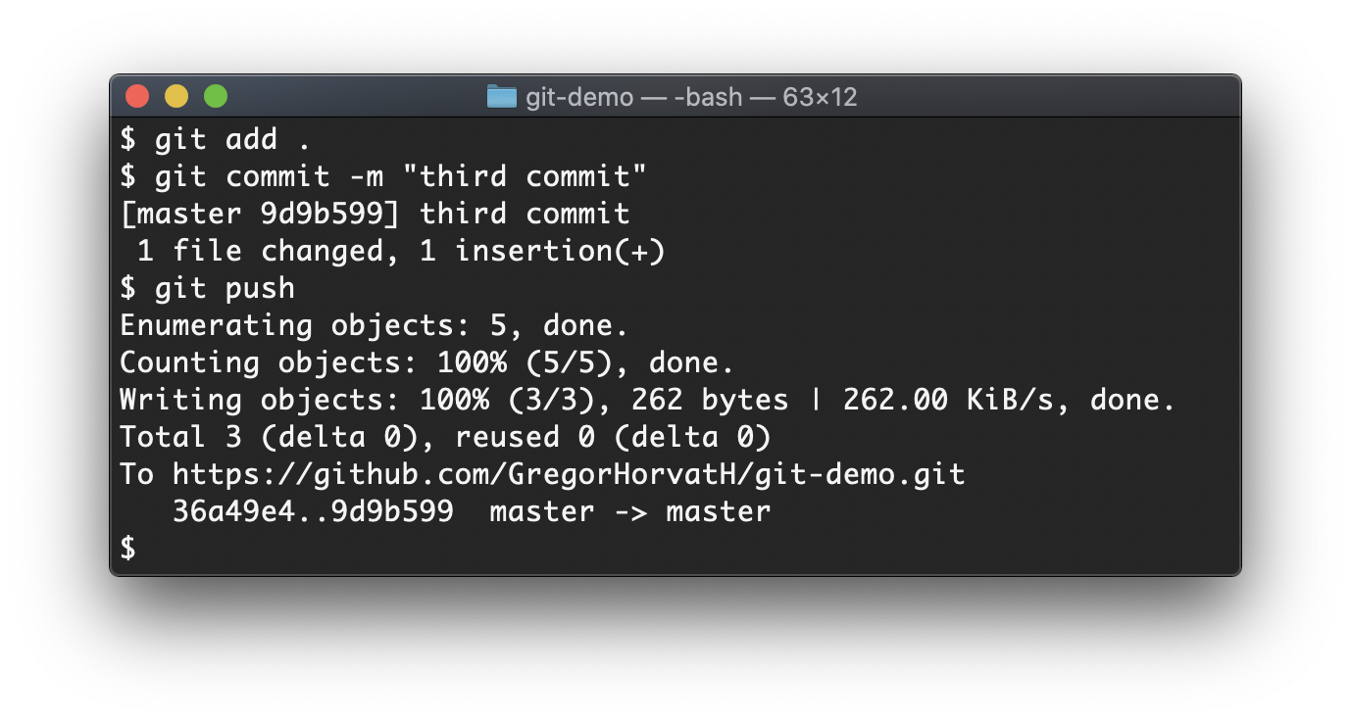
Clone the remote repository
create new repository, variant 2
git clone https://github.com/YOUR-GIT/git-demo.git
cd git-demo
… make changes …
git add .
git commit -m “first commit”
git push

Slide 18
Frequently used commands
https://dzone.com/articles/top-20-git-commands-with-examples
clone the remote repository
check the status
add file(s) to commit
commit changes
push changes to server
fetch changes from the server
git clone [url]
git status
git add [filename] | git add .
git commit -m [comment]
git push
git pull

Slide 19
branches
A branch represents an independent line of development

Slide 20
create new branch
git checkout -b [new_branch]*
… make changes …
git add .
git commit -m [comment]
git push --set-upstream origin [new_branch]*
*only for the first push into the new_branch

Slide 21
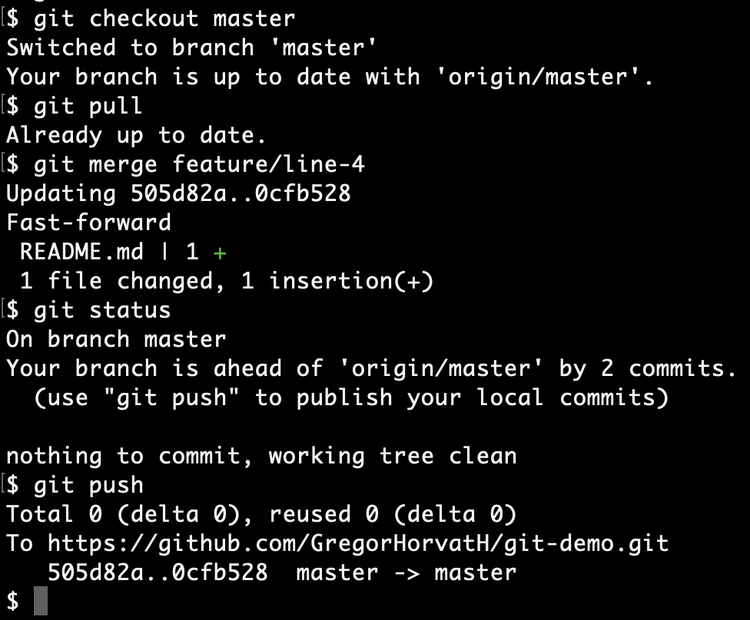
merge branch to the master
git checkout master
git merge feature/line-4
git push

Slide 22
Merge conflicts
git pull
… solve conflicts …
git add .
git commit -m “fix”
git push

Slide 23
Useful links
https://dzone.com/articles/top-20-git-commands-with-examples
https://git-scm.com/book/ru/v1/Введение-Основы-Git

Slide 24
QUESTIONS

Slide 25
Thank you
https://gitlab.com/GregorHorvatH/git-firststeps
https://t.me/GregoryHorvath

